Slide 1

ONLINE FOOD ORDERING SYSTEM
Mitali Chaudhari 20104104
Sampada Mahadik 20104092
Sakshi Parab 20104059
Parthavi Khatu 20104108
Project Guide
Prof. Susmita Das

Slide 2
Contents
Introduction
Objectives
Scope
Features / Functionality
Project Outcomes
Technology Stack
Block Diagram

Slide 3
1. Introduction
Our Food Ordering System re-creates the concept of “Online kitchens” where customers can select chefs and their favorite dishes to enjoy their food at the comfort of their homes.
The rapid growth in the use of internet and the technologies associated with it, the several opportunities are coming up on the web or mobile application.

Slide 4
1. Introduction
Problem Identified
In this covid situation, Maintaining social distancing and to get the order food/ item at the door step.
Solution Proposed
By using our system, customer will be able to order the food within few seconds by sitting at home with just few clicks.

Slide 5
2. Objectives
To develop online ordering system.
To provide online menu information for customer.
To provide online menu information about chefs and availability of their specialized food dishes to customers.

Slide 6
3. Scope
Provides scope to both customers and chefs to create one-to-one business to customer scenario.
Can be helpful to increase the interaction between the chefs and the customers.

Slide 7
4. Feature /Functionality
Easy communicative
Time saving
Feedback/ reviews
Have freedom to choose their chefs dishes.

Slide 8
5. Outcome of Project
Customer's satisfaction.
Increase in Sales.
User’ can order whenever they want.
Efficient customer and order management.
Better control.

Slide 9
6. Technology Stack
FRONTEND
IDE:- Visual Studio Code
Programming Language:- Python
BACKEND
SQLLITE

Slide 10
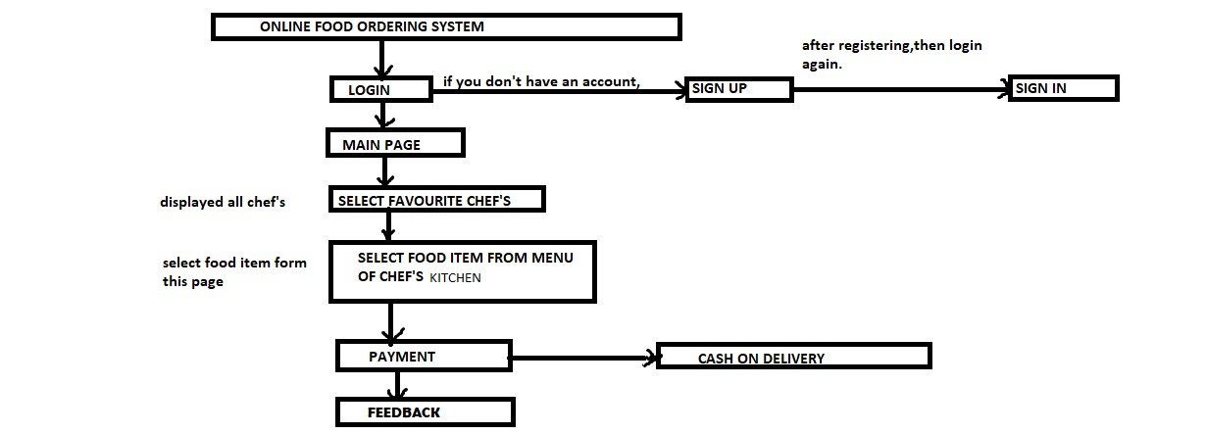
7. Block Diagram

Slide 11
Thank You...!!

